Slide 1
Shell Bootcamp 2024 3 Reflections for Week 1
Nandini Maheshwari
Date : 31-Aug-2024

Slide 2

About Me
Please share a phrase that represents
your motto in life
“Create Your Own
Sunshine”

Slide 3

My learnings from this week!

Slide 4

Learning 1 | My takeaways
Details of the learning:
Emotional intelligence: It refers to the ability to recognize, understand, manage, and utilize emotions effectively in oneself and in interactions with others.
Active Listening: Techniques for truly understanding and responding to the emotions and perspectives of others.
Fixed Mindset: Pessimism
Growth Mindset: Optimism
E-Mail Writing: Plan Organize Write Edit Review (POWER)
[Add a graphic that provides evidence of what you learned]

Slide 5

Learning 2 | My takeaways
Please share (in your own words) details of the learning.
Stakeholder Management.
How does a professional behave ?
Deadline complexity.
Stakeholder management and types of stakeholders.
Team work and how to deal with the team.

Slide 6
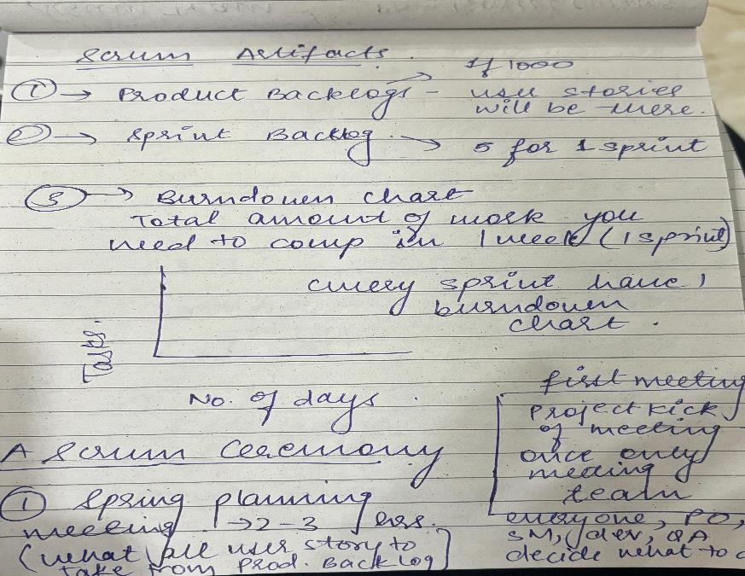
Learning 3 | My takeaways
Please share (in your own words) details of the learning.
Requirement Analysis, Elicitation, Management, Traceability.
Scrum has high velocity, adaptability and is customer centric.
Improved Risk Management, Better Stakeholder Engagement, Improved Safety and Compliance.

Slide 7

Relevance of learnings for my organization

Slide 8
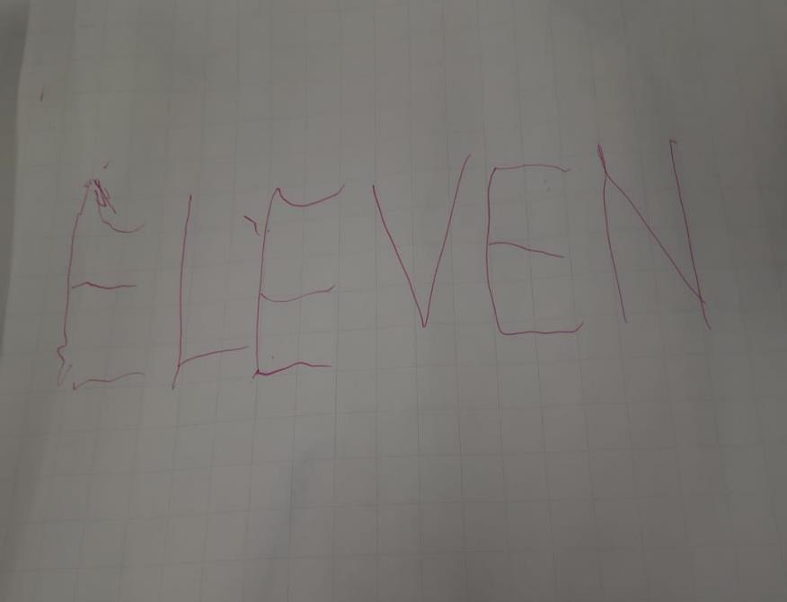
Learning 1 | Relevance for Shell
How I feel Shell implements this learning?
By providing support and training to grow.
Promoting growth mindset.
By creating a healthy and helpful environment.
How I feel Shell benefits from this learning?
Enhanced Teamwork and Collaboration
Better Leadership and Management
Strengthened Organizational Culture

Slide 9
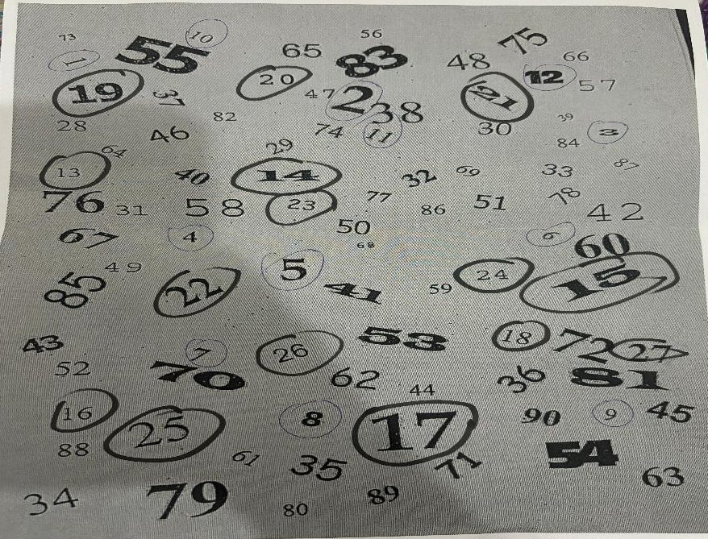
Learning 2 | Relevance for Shell
How I feel Shell implements this learning ?
Effectively teaching the team work and carrying out activities.
Carrying out different programs for leaning soft skills and technical skills.
How I feel Shell benefits from this learning ?
Better Decision-Making
Enhanced Compliance and Regulatory Adherence
Competitive Advantage

Slide 10
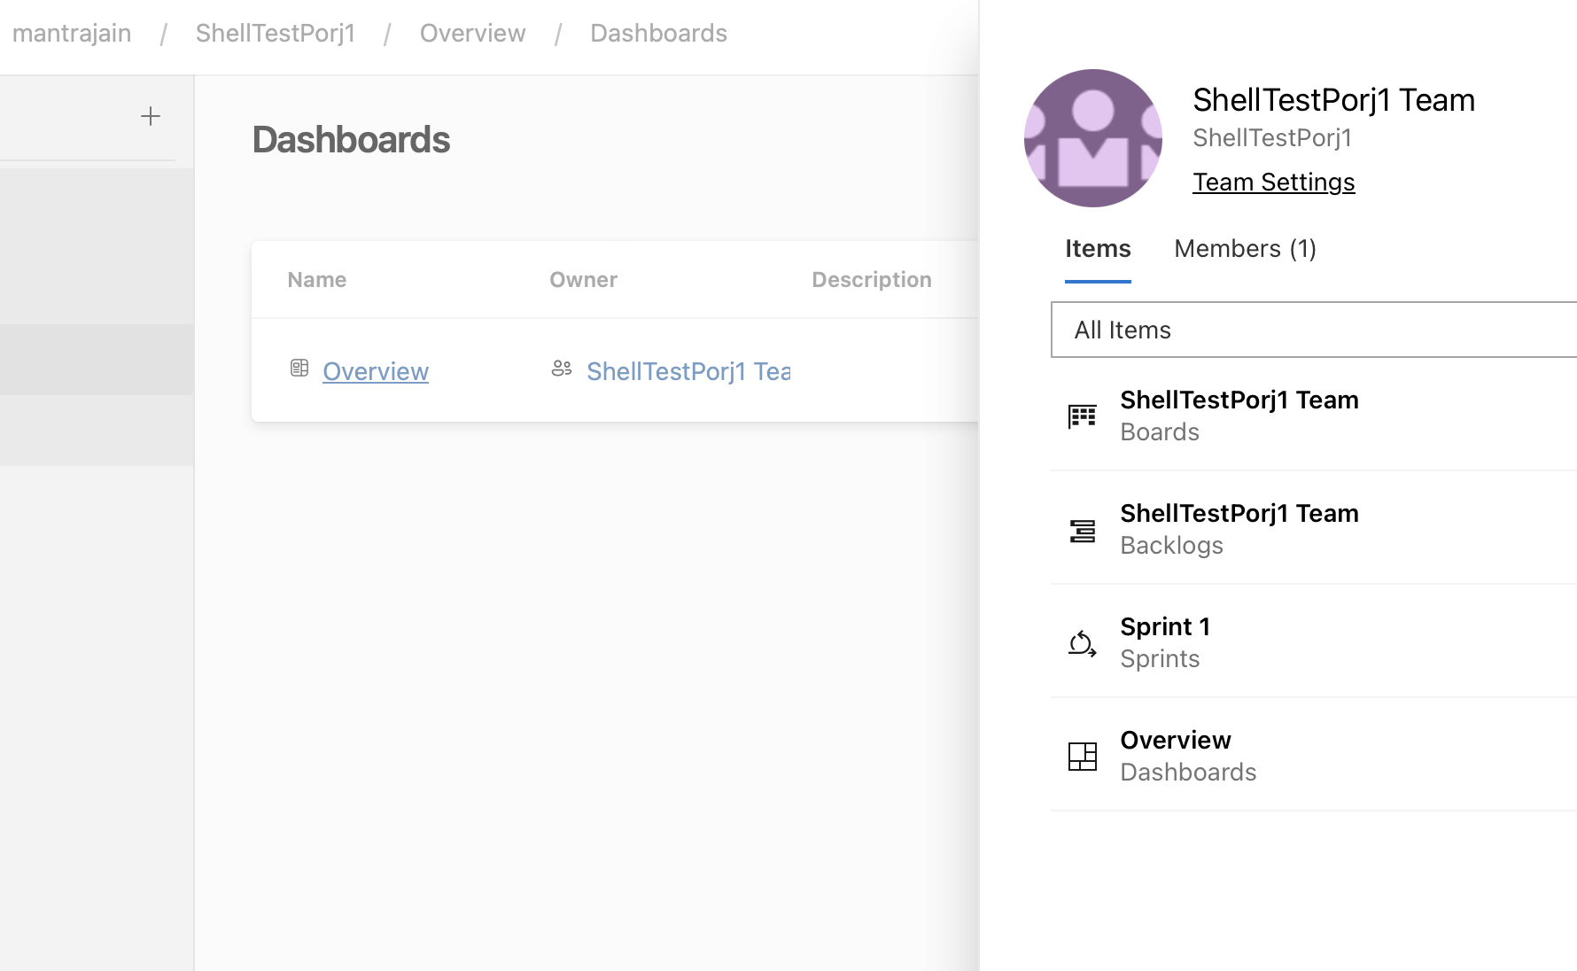
Learning 3 | Relevance for Shell
How I feel Shell implements this learning (in your own words)
Process Efficiency
Foster Agile Culture
Track Metrics: Use Agile metrics (e.g., velocity, burn-down charts) to monitor progress and performance.
How I feel Shell benefits from this learning ?
Leverage Technology
Scale Agile Practices
Improved Collaboration

Slide 11

Challenges in implementing learning

Slide 12

Challenge faced while implementing Learning 1
What were the challenges I faced while implementing Learning 1 and my plan to overcome them
1.Accepting new culture
2. Resistance to Change
3. Fear of Judgment
Solution:
Use interactive techniques such as role-playing, group discussions.
Networking

Slide 13
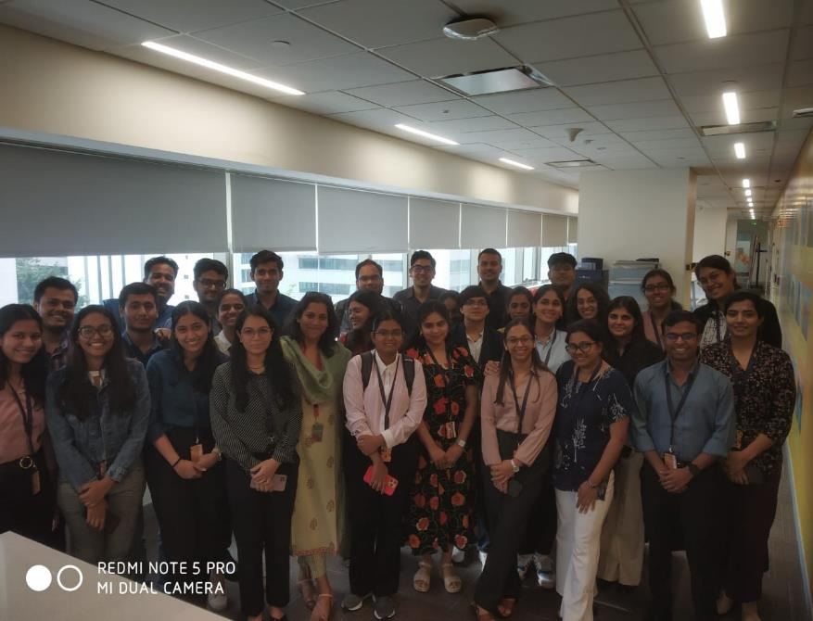
Challenge faced while implementing Learning 2
What were the challenges I faced while implementing Learning 2 and my plan to overcome them
Applying Theory to Practice
Cultural Differences
Solution:
Role-Playing: Conduct role-playing exercises where participants simulate stakeholder.
Templates and Tools: Provide templates for mapping strategies to help us apply what we have learned.

Slide 14
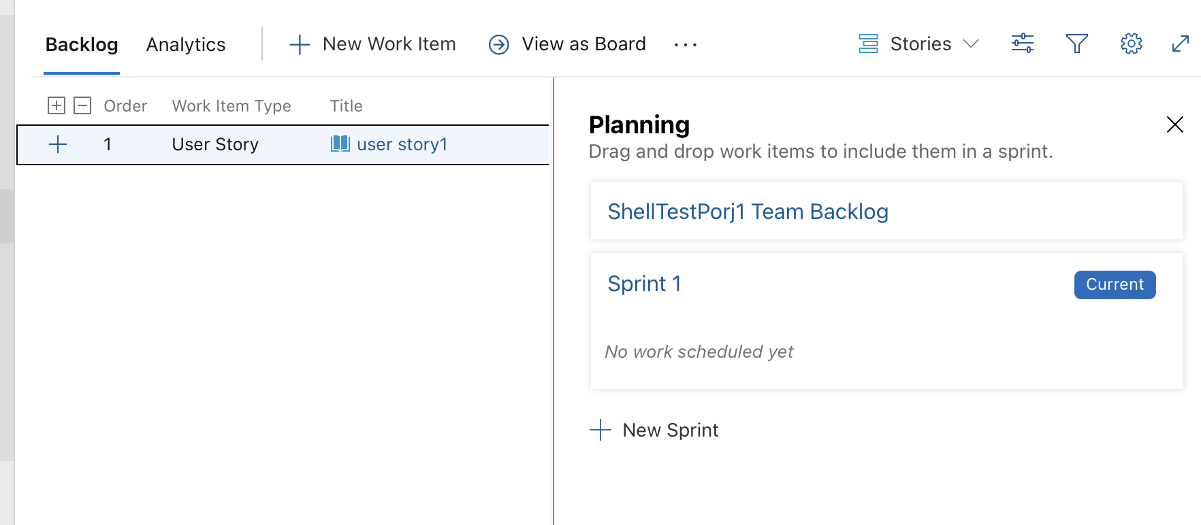
Challenge faced while implementing Learning 3
What were the challenges I faced while implementing Learning 3 and my plan to overcome them
Applying Theory to Practice.
Adapting to New Tools and Techniques.
Balancing Agile with Organizational Structure
Solution:
Peer Learning
Simulations
Regular Reviews

Slide 15

Action Plan

Slide 16
My Action Plan for this Week
Actions
Timeline
Status
Mentoring and Coaching: Provide ongoing mentoring and coaching on critical aspects of project management and SDLC .
Visual Aids: Use Agile boards, charts, and visual models to illustrate key principles and practices.
Preparation and Planning
Assess Needs: Identify participant challenges and skill levels.
Develop Materials: Create training resources, including visual aids and practical exercises.
Made Account on Azure Agile and implemented Epics, Features and Tasks.

Slide 17

Learning is also Fun!

Slide 18
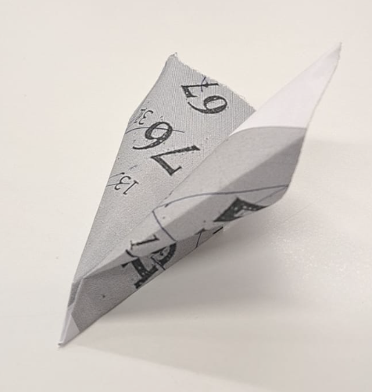
Learning is also Fun!
Please share how ”Your” learning was fun this week
Started a round where we introduced the person sitting next to us and telling something unique and funny quality about the person.
Did a group project where we created BRD and SRS with the topic given by mentor.

Slide 19

Summary
Importance of topics of upcoming week
Scrum artifacts
Detail under User story
Burndown Charts
Connectivity of topics from current week
Development
Q/A
Staging
Production

Slide 20
Thank You

